Slide 1
EAD Update
10/25/2023
(p)NFH(D2)

Slide 2
Main points
Best fits for NFH with and without phospho, with and without D2 (residues 36-72)
Methodology
AA chi’s consistent between 4 samples, now using relative values from Monera 1995 (Sigma Aldrich) and changing maximum value
Heights based on density(H) = threshold
Takeaways:
Trends captured, some difficulties with pNFH
Best fits increase segment volume after phosphorylation
Phosphorylation charge = -1 e
2 options for pNFH parameters
Best fit but more complex morphology
Worse fit but straight-forward morphology

Slide 3
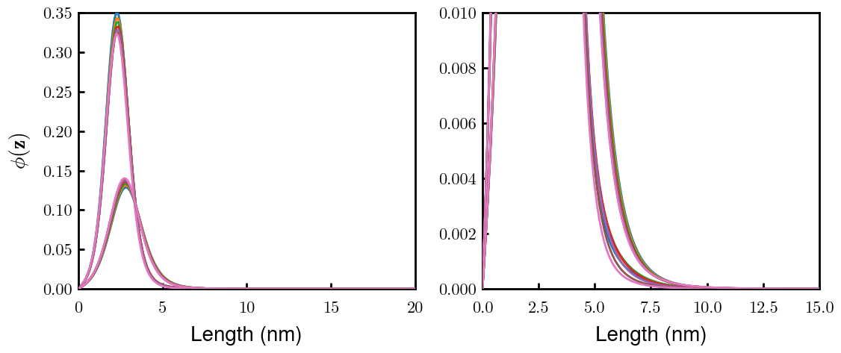
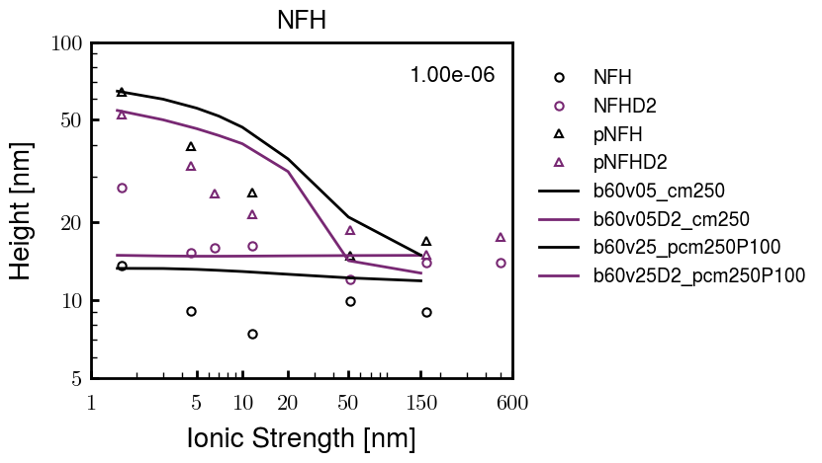
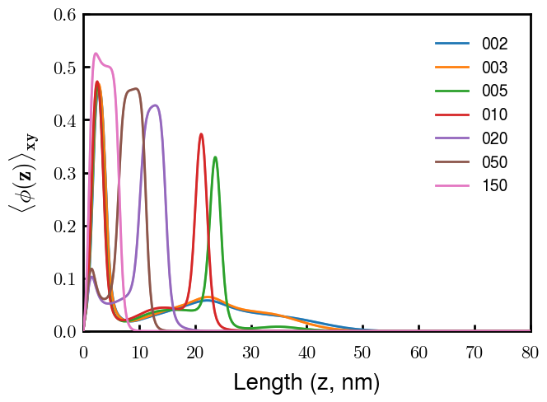
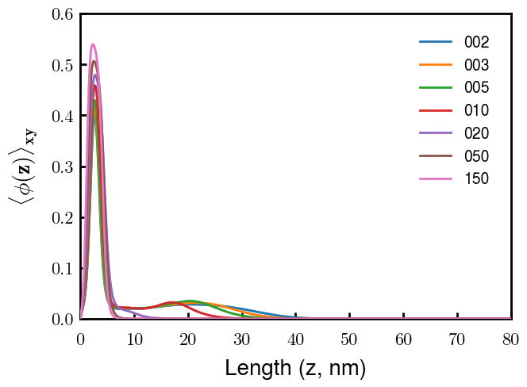
Best fit: overview
NFH
NFHD2
pNFH
pNFHD2
(v= -1)
(v = -1)
Points
v05 → v25 after phosphorylation
Bilayer pNFH morphology

Slide 4
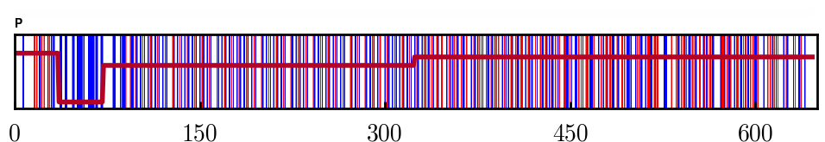
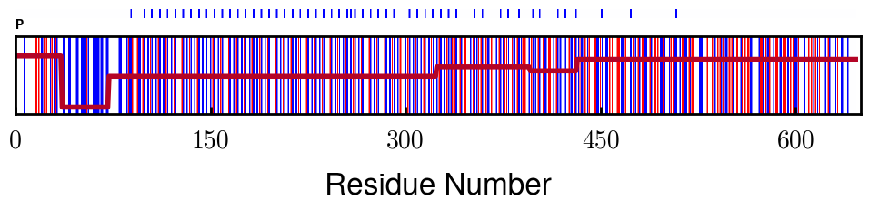
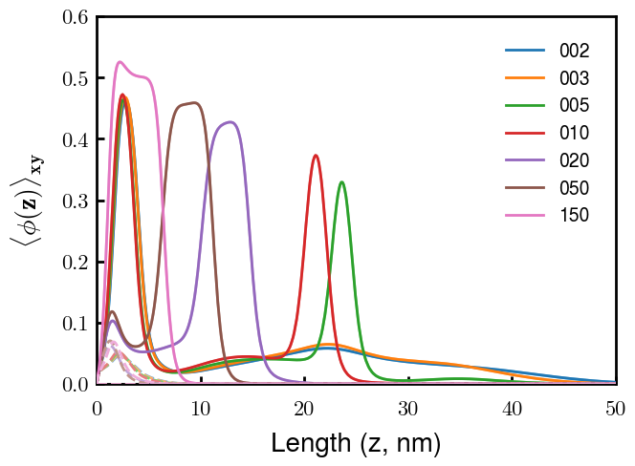
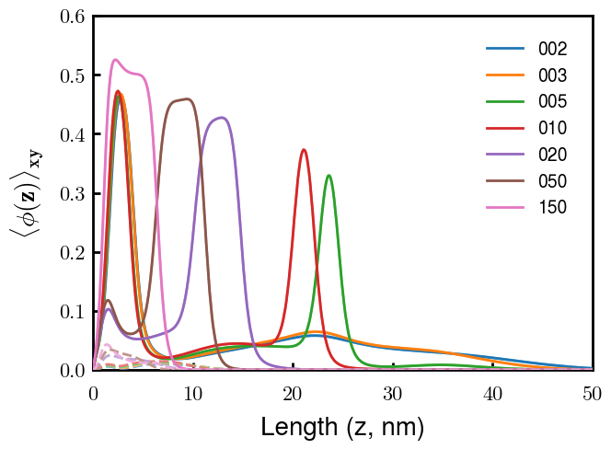
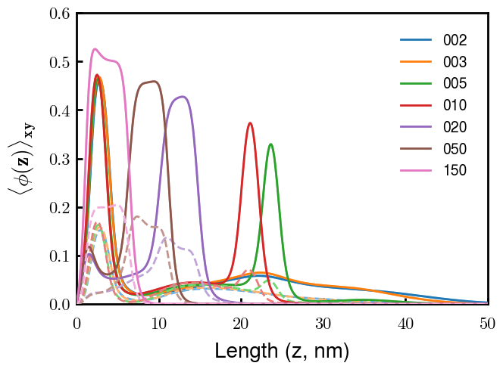
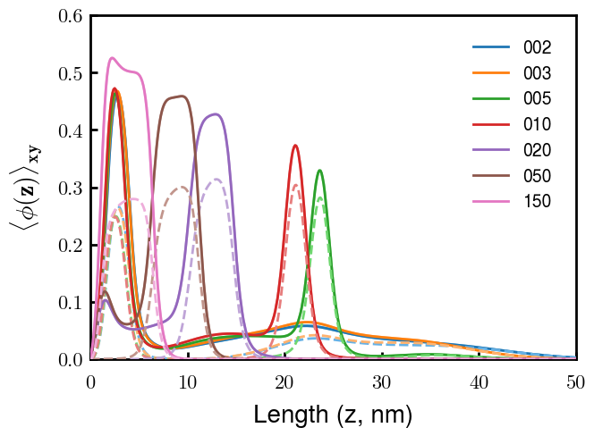
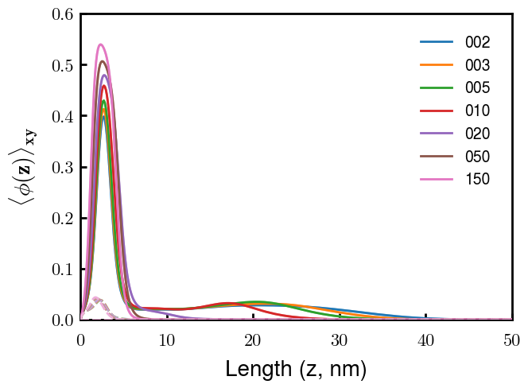
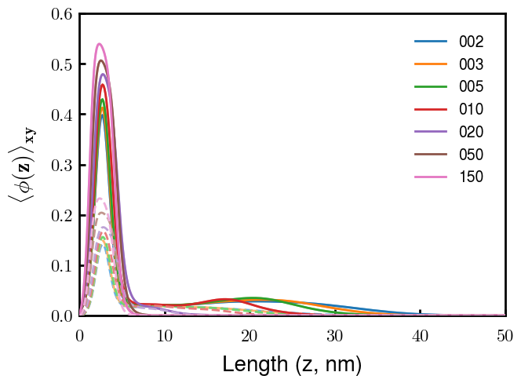
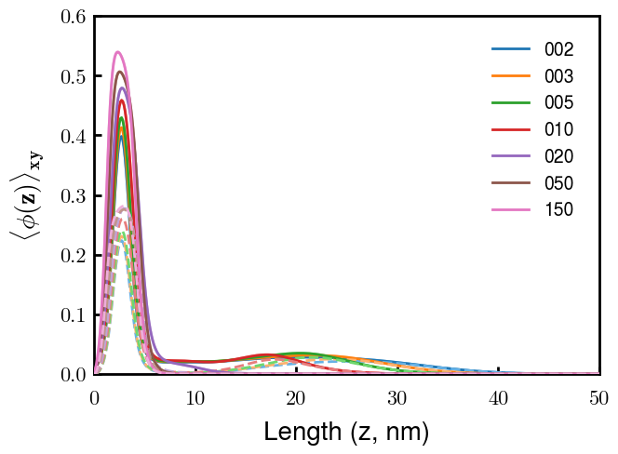
Best fit: pNFH(D2) brush morphology
k = 1
k = 2
k = 3
k = 4
Multilayer caused by highly charged 2nd block
Morphologies at 20, 50: mushroom far from surface
D2

Slide 5
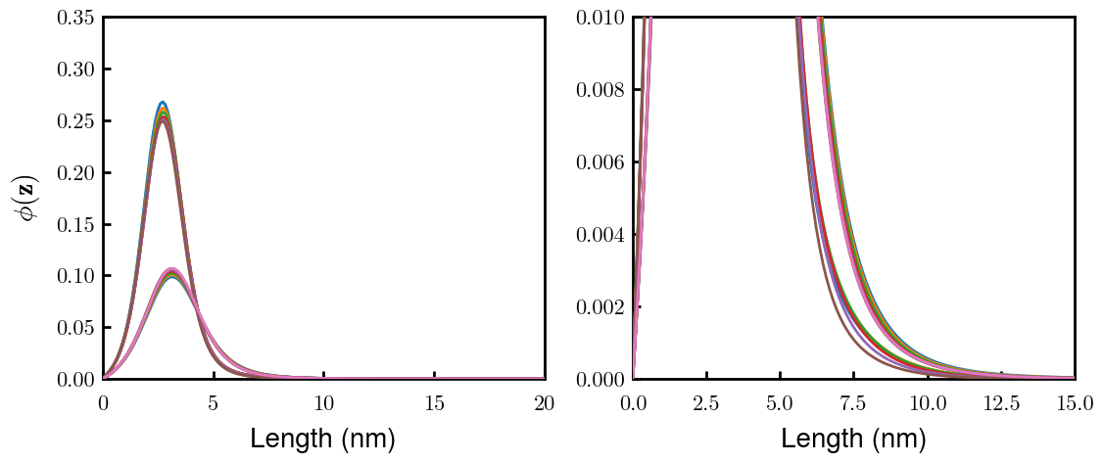
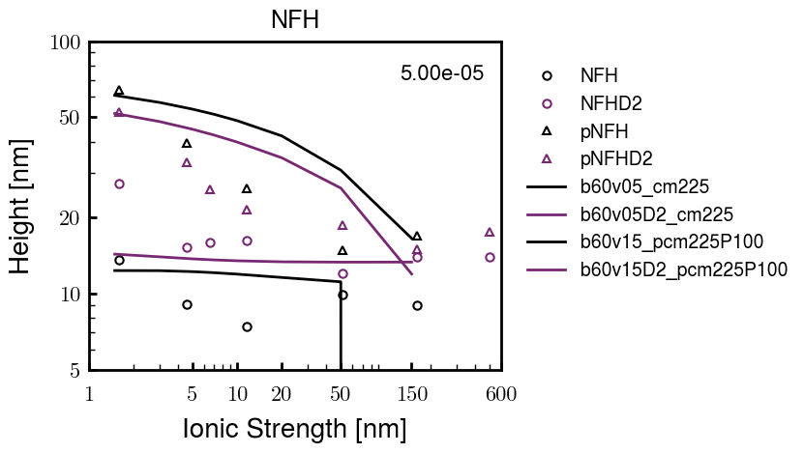
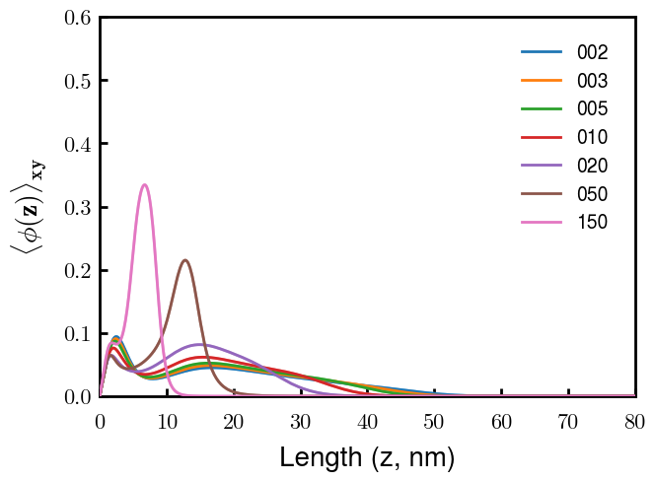
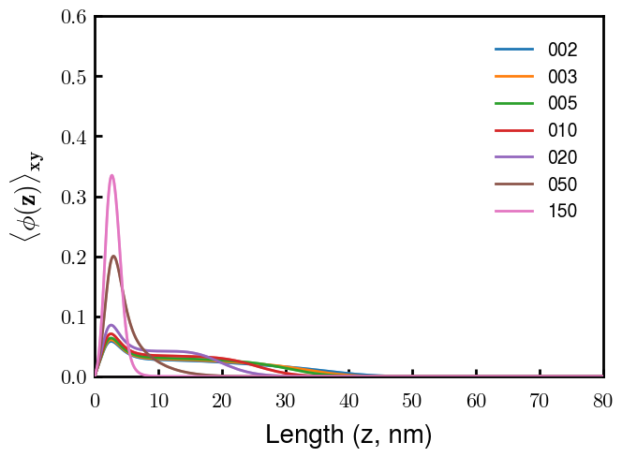
Non-multilayer best fit: overview
NFH
NFHD2
pNFH
pNFHD2
(v = -1)
(v = -1)
Points
v05 → v15 after phosphorylation
No condensed multilayer but worse fit

Slide 6
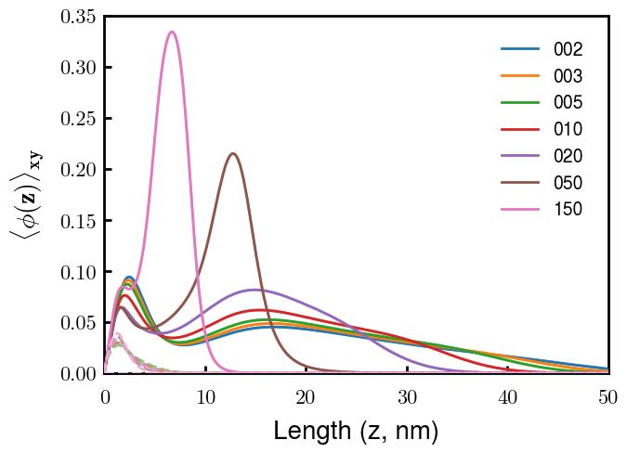
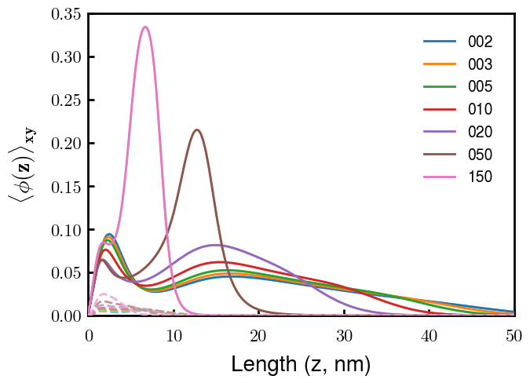
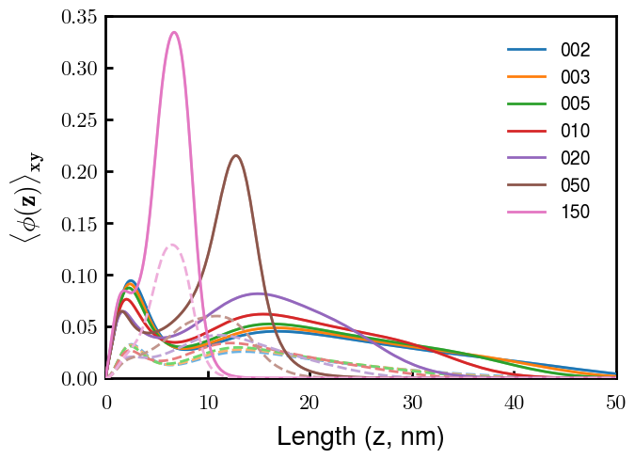
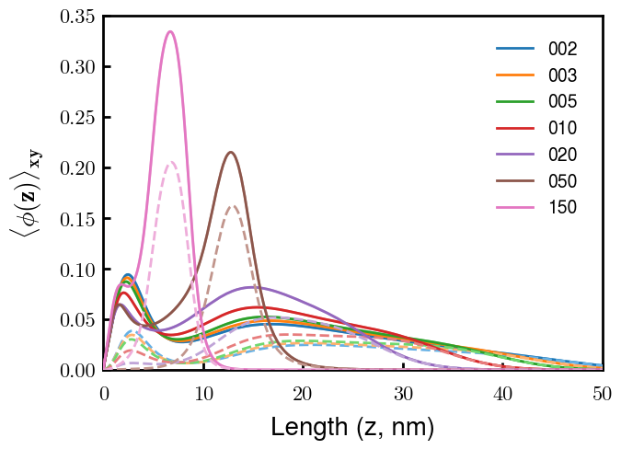
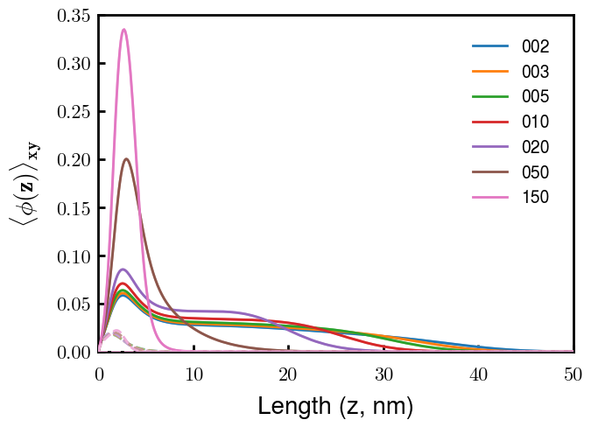
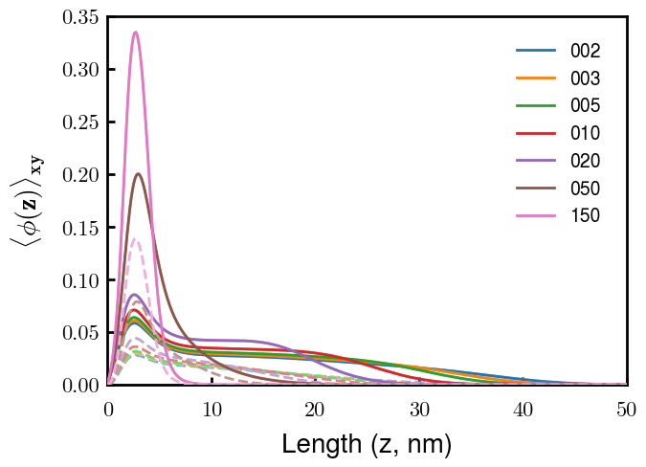
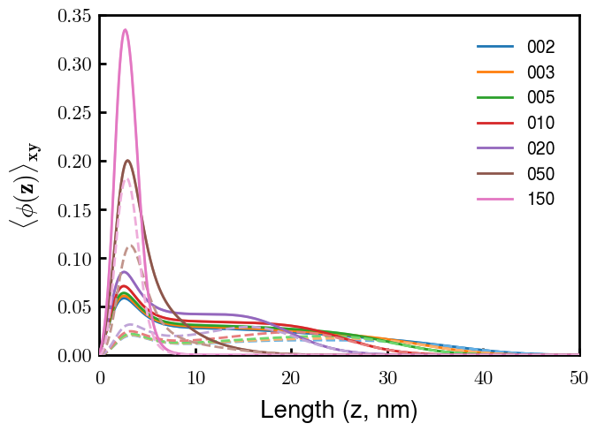
Non-multilayer best fit: morphology
k = 1
k = 2
k = 3
k = 4
Multilayer caused by highly charged 2nd block
Morphology at 50: mushroom far from surface
D2

